Slide 1
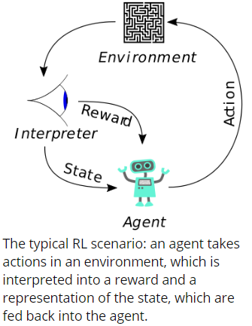
What is reinforce learning ?
Reinforcement Learning(RL) is learning what to do—how to map situations to actions—so as to maximize a numerical reward signal.
It is a type of machine learning technique that enables an agent to learn in an interactive environment by trial and error using feedback from its own actions and experiences.
It aims to find a suitable action model that would maximize the total cumulative reward of the agent.
Notes:
Reinforcement learning is learning what to do—how to map situations to actions—so as to maximize a numerical reward signal.

Slide 2
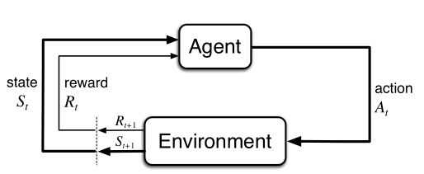
Markov Decision Processes (MDPs)
Markov Decision Processes (MDPs) are mathematical frameworks to describe an environment in reinforcement learning and almost all RL problems can be formalized using MDPs.
Environment: Physical world in which the agent operates
State: Current situation of the agent
Reward: Feedback from the environment
Policy: Method to map agent’s state to actions
Value: Future reward that an agent would receive by taking an action in a particular state

Slide 3
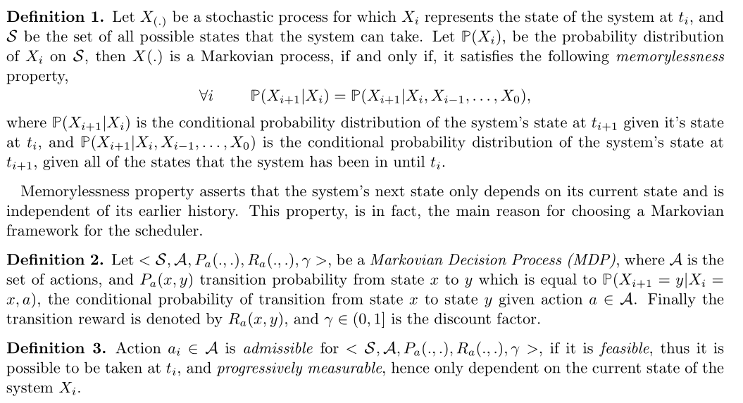
An MDP consists of a set of finite environment states S, a set of possible actions A(s) in each state, a transition model P_{a} (s’, s | a), a real valued reward function R_{a}(s) and a discount factor γ. The discount rate determines the present value of future rewards

Slide 4
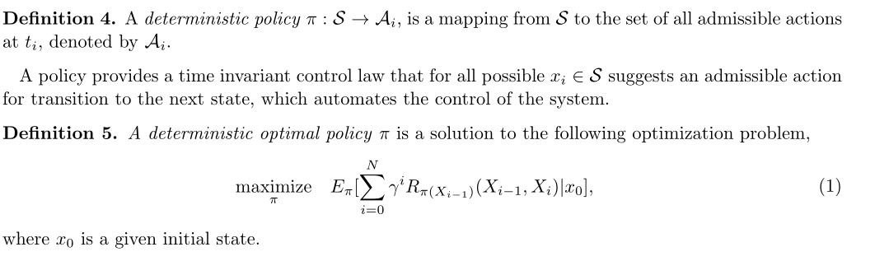
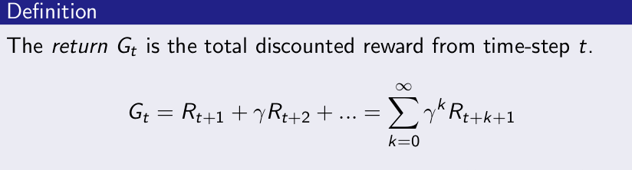
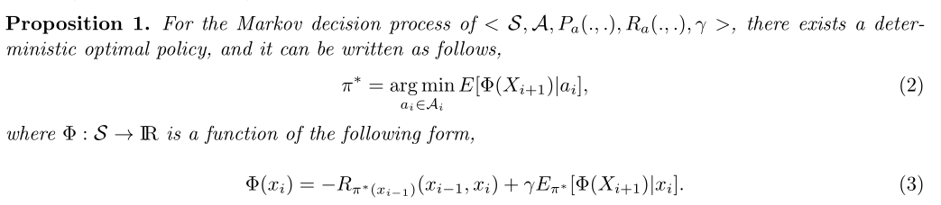
A policy defines the learning agent’s way of behaving at a given time
The agent’s goal is to maximize the cumulative reward it receives in the long run and a value function specifies what is good in the long run
optimal expected long-term return
Current rewards

Slide 5
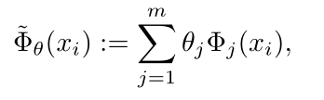
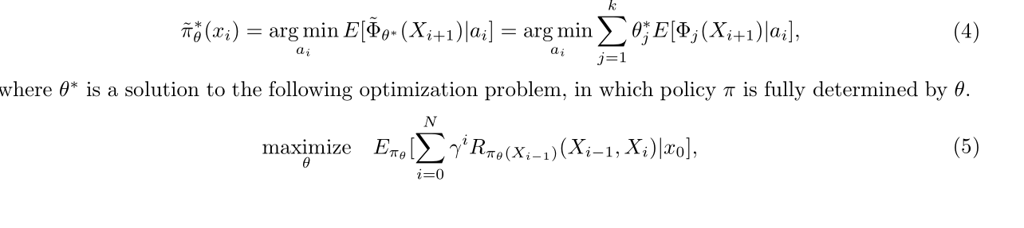
Markovian approximation
1. Reduce the state space: designed a set of features to summarize the most important information required for the scheduling, the system of telescope-environment is only an approximated Markovian system, once its state-space is replaced by a feature-space
2. Despite this reduction, Problem (1) is still an infinite dimensional optimization problem because its variable is a function and we propose a parametrized function approximation
With this approximation, the space of search is reduced from the space of functions to a finite dimensional vector space. This approximation substitutes the original optimal policy (2) with the following approximate policy,

Slide 6
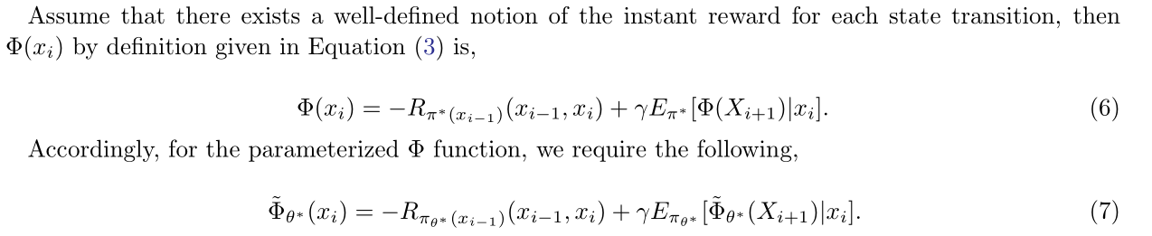
Reinforcement Learning
Learning rate
Learned value
Old value
Estimate of optimal future value
rewards

Slide 7
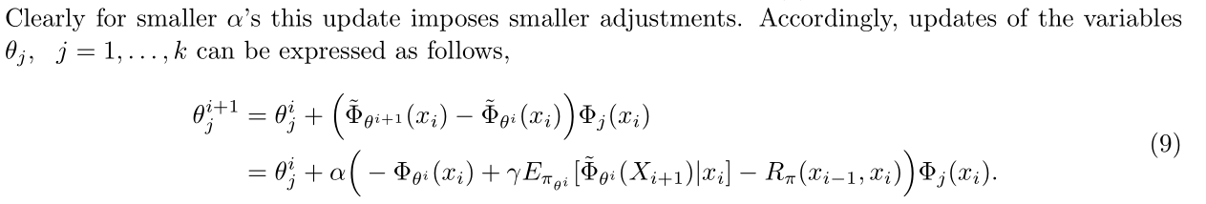
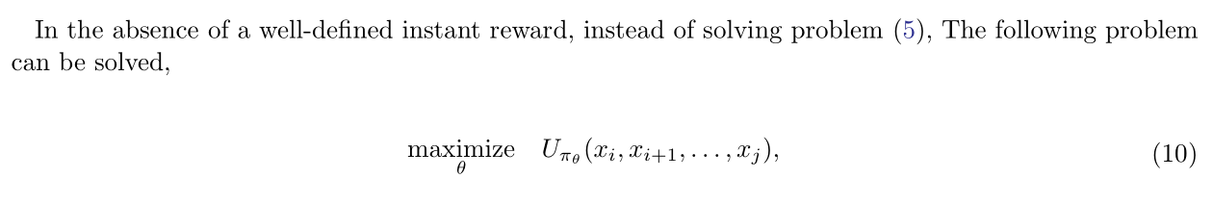
Reinforcement Learning
This Learning method is called Temporal-Difference (TD) learning with function approximation (Tsit-siklis & Van Roy 1997). Variants of this reinforcement learning method have been successfully applied to real-life problems such as training of a backgammon player (Tesauro 1995).

